Slide 1
Sentiment Analysis of British Airways Customer Reviews
By Akassh Manikandan
MS Advanced Computer Science
University of Leicester

Slide 2
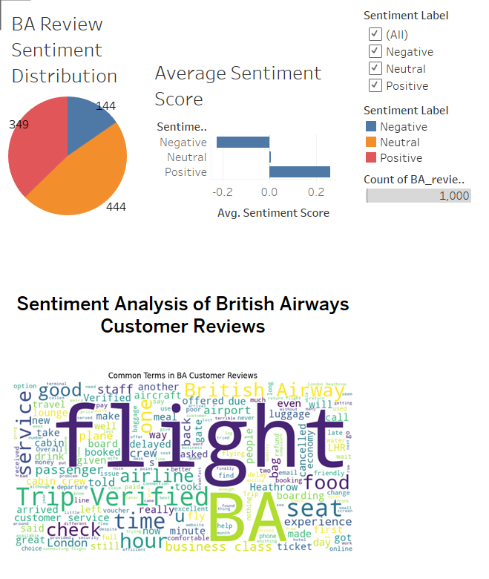
Summary
Insights:
1000 reviews analyzed using sentiment scoring and text mining.
44% Positive, 35% Negative, 21% Neutral sentiments.
Average sentiment score: +0.037 – slightly positive overall.
Most frequent terms: flight, BA, seat, service, trip.
Complaints often linked to delays, cramped seats, and customer service.
Praise primarily focuses on on-time flights, crew behavior, and ticketing ease.
Dashboard created in Tableau, dataset: 1,000 Skytrax reviews (May 2025)
Recommendations:
Improve comfort on economy seating – frequent complaint topic.
Enhance customer service responsiveness and training.
Optimize boarding and delay management processes.
Continue positive efforts around punctuality and in-flight crew professionalism.
Use sentiment tracking routinely to monitor customer satisfaction trends.

